Slide 1
4 Squared Fractions

Slide 2
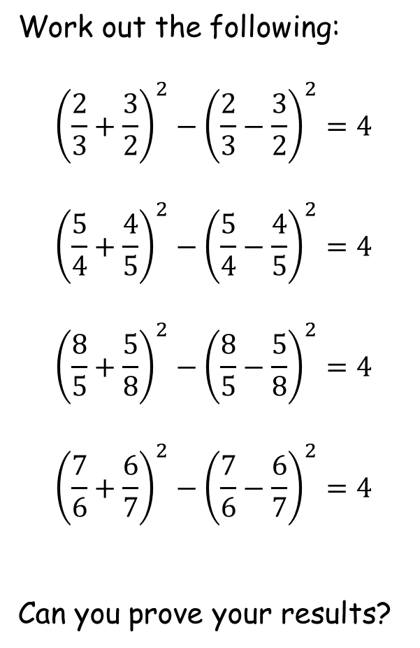
4 Squared Fractions
Work out the following:
$${\left(\frac{2}{3}+\frac{3}{2}\right)}^{2}−{\left(\frac{2}{3}−\frac{3}{2}\right)}^{2}=4$$
$${\left(\frac{5}{4}+\frac{4}{5}\right)}^{2}−{\left(\frac{5}{4}−\frac{4}{5}\right)}^{2}=4$$
$${\left(\frac{8}{5}+\frac{5}{8}\right)}^{2}−{\left(\frac{8}{5}−\frac{5}{8}\right)}^{2}=4$$
$${\left(\frac{7}{6}+\frac{6}{7}\right)}^{2}−{\left(\frac{7}{6}−\frac{6}{7}\right)}^{2}=4$$
Can you prove your results?

Slide 3
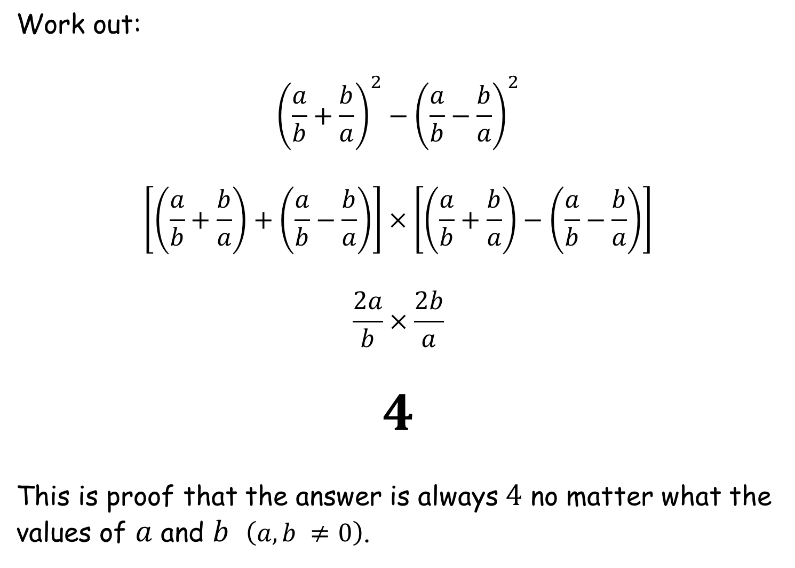
Work out:
$${\left(\frac{a}{b}+\frac{b}{a}\right)}^{2}−{\left(\frac{a}{b}−\frac{b}{a}\right)}^{2}$$
$$\left[\left(\frac{a}{b}+\frac{b}{a}\right)+\left(\frac{a}{b}−\frac{b}{a}\right)\right]×\left[\left(\frac{a}{b}+\frac{b}{a}\right)−\left(\frac{a}{b}−\frac{b}{a}\right)\right]$$
$$\frac{2a}{b}×\frac{2b}{a}$$
$$4$$
This is proof that the answer is always $4$ no matter what the values of $a$ and $b$ $\left(a,b ≠0\right)$.
(difference of two squares!)

Slide 5
RESOURCES

Slide 6
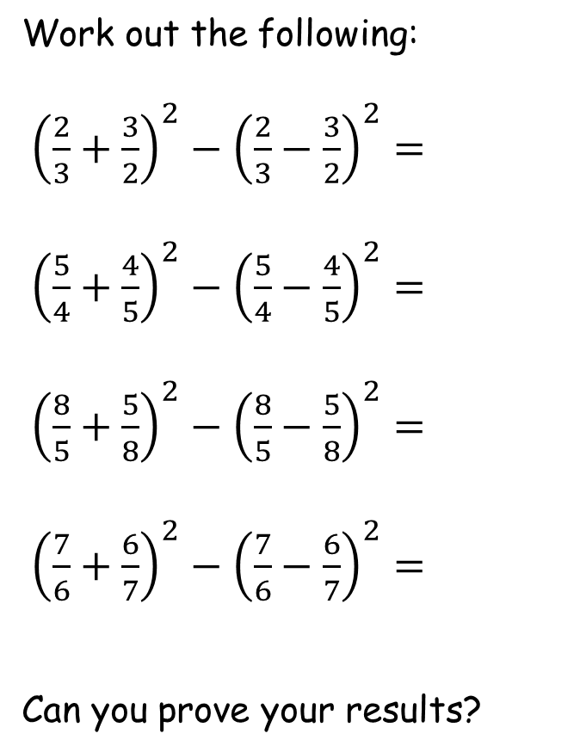
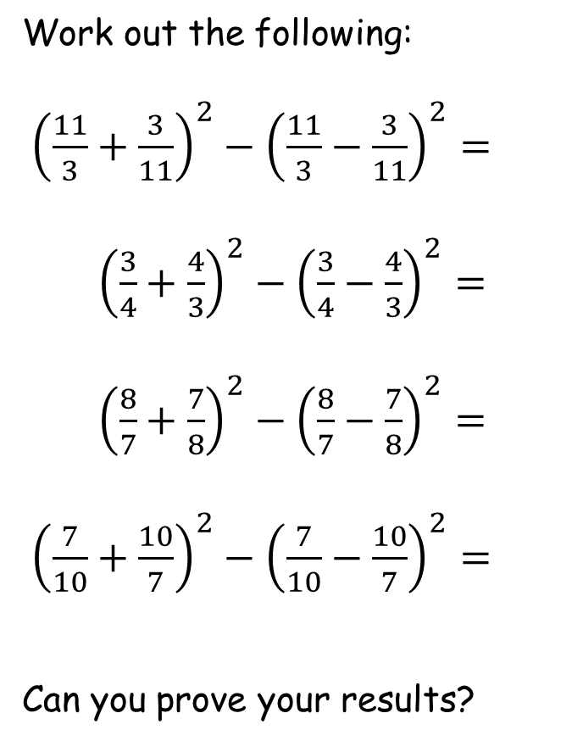
SIC_61
SIC_61
4 Squared Fractions
4 Squared Fractions
Work out the following:
${\left(\frac{2}{3}+\frac{3}{2}\right)}^{2}−{\left(\frac{2}{3}−\frac{3}{2}\right)}^{2}=$
${\left(\frac{5}{4}+\frac{4}{5}\right)}^{2}−{\left(\frac{5}{4}−\frac{4}{5}\right)}^{2}=$
${\left(\frac{8}{5}+\frac{5}{8}\right)}^{2}−{\left(\frac{8}{5}−\frac{5}{8}\right)}^{2}=$
${\left(\frac{7}{6}+\frac{6}{7}\right)}^{2}−{\left(\frac{7}{6}−\frac{6}{7}\right)}^{2}=$
Can you prove your results?
Work out the following:
${\left(\frac{11}{3}+\frac{3}{11}\right)}^{2}−{\left(\frac{11}{3}−\frac{3}{11}\right)}^{2}=$
${\left(\frac{3}{4}+\frac{4}{3}\right)}^{2}−{\left(\frac{3}{4}−\frac{4}{3}\right)}^{2}=$
${\left(\frac{8}{7}+\frac{7}{8}\right)}^{2}−{\left(\frac{8}{7}−\frac{7}{8}\right)}^{2}=$
${\left(\frac{7}{10}+\frac{10}{7}\right)}^{2}−{\left(\frac{7}{10}−\frac{10}{7}\right)}^{2}=$
Can you prove your results?

Slide 7
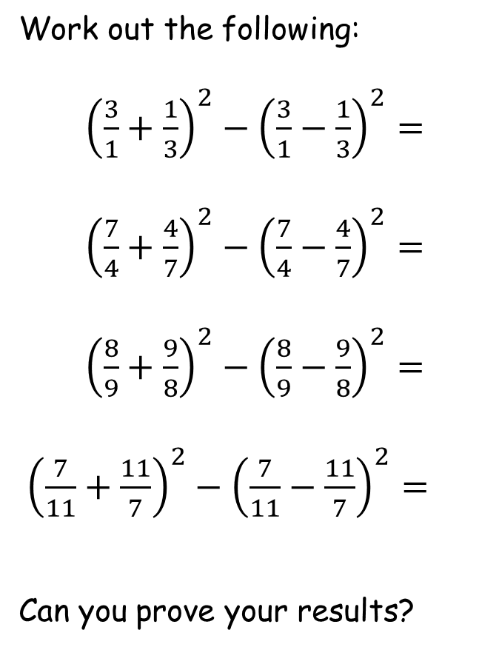
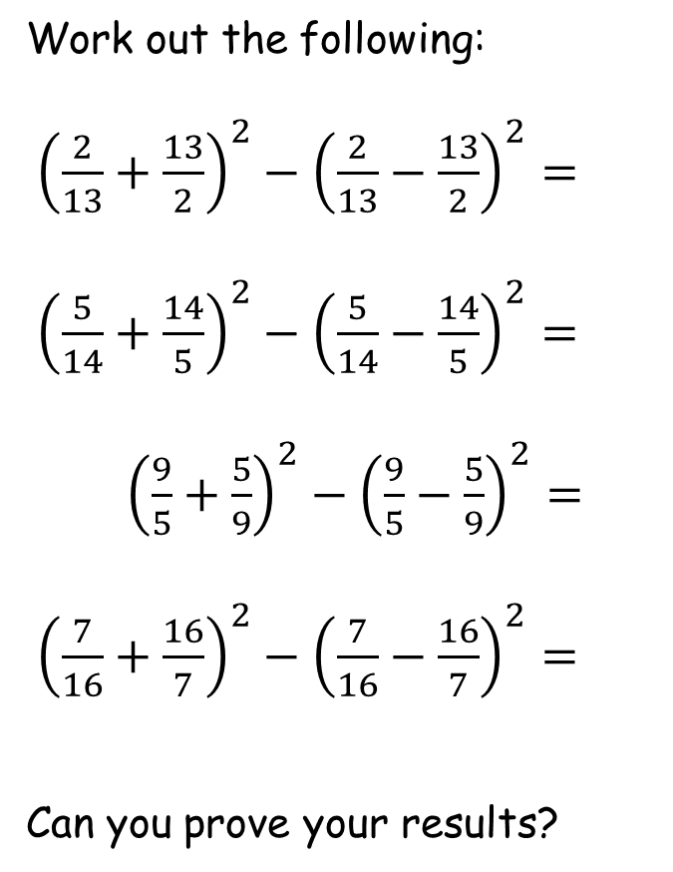
SIC_61
SIC_61
4 Squared Fractions
4 Squared Fractions
Work out the following:
${\left(\frac{3}{1}+\frac{1}{3}\right)}^{2}−{\left(\frac{3}{1}−\frac{1}{3}\right)}^{2}=$
${\left(\frac{7}{4}+\frac{4}{7}\right)}^{2}−{\left(\frac{7}{4}−\frac{4}{7}\right)}^{2}=$
${\left(\frac{8}{9}+\frac{9}{8}\right)}^{2}−{\left(\frac{8}{9}−\frac{9}{8}\right)}^{2}=$
${\left(\frac{7}{11}+\frac{11}{7}\right)}^{2}−{\left(\frac{7}{11}−\frac{11}{7}\right)}^{2}=$
Can you prove your results?
Work out the following:
${\left(\frac{2}{13}+\frac{13}{2}\right)}^{2}−{\left(\frac{2}{13}−\frac{13}{2}\right)}^{2}=$
${\left(\frac{5}{14}+\frac{14}{5}\right)}^{2}−{\left(\frac{5}{14}−\frac{14}{5}\right)}^{2}=$
${\left(\frac{9}{5}+\frac{5}{9}\right)}^{2}−{\left(\frac{9}{5}−\frac{5}{9}\right)}^{2}=$
${\left(\frac{7}{16}+\frac{16}{7}\right)}^{2}−{\left(\frac{7}{16}−\frac{16}{7}\right)}^{2}=$
Can you prove your results?

Slide 8
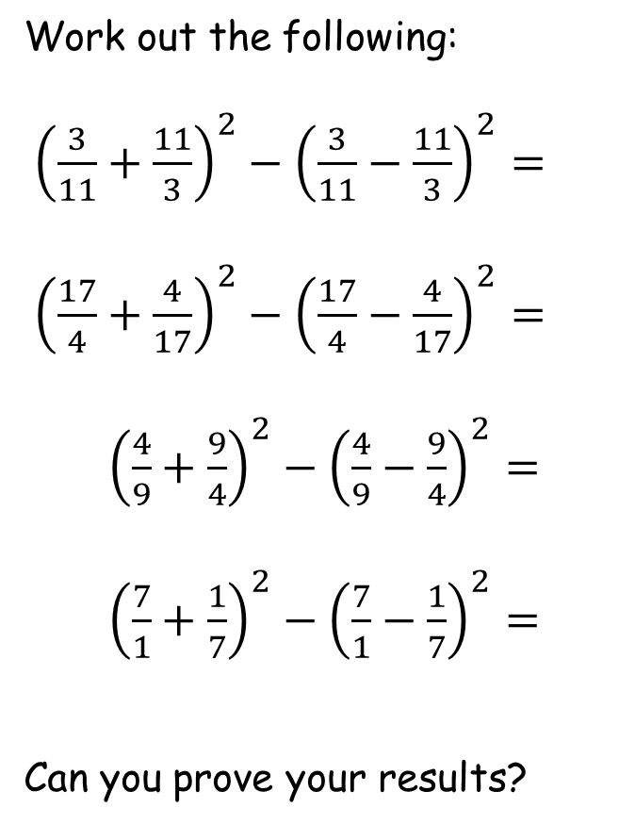
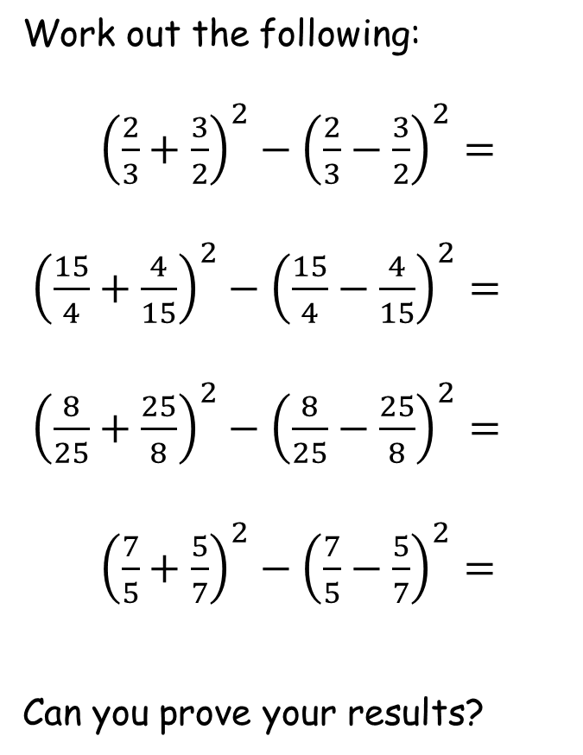
SIC_61
SIC_61
4 Squared Fractions
4 Squared Fractions
Work out the following:
${\left(\frac{3}{11}+\frac{11}{3}\right)}^{2}−{\left(\frac{3}{11}−\frac{11}{3}\right)}^{2}=$
${\left(\frac{17}{4}+\frac{4}{17}\right)}^{2}−{\left(\frac{17}{4}−\frac{4}{17}\right)}^{2}=$
${\left(\frac{4}{9}+\frac{9}{4}\right)}^{2}−{\left(\frac{4}{9}−\frac{9}{4}\right)}^{2}=$
${\left(\frac{7}{1}+\frac{1}{7}\right)}^{2}−{\left(\frac{7}{1}−\frac{1}{7}\right)}^{2}=$
Can you prove your results?
Work out the following:
${\left(\frac{2}{3}+\frac{3}{2}\right)}^{2}−{\left(\frac{2}{3}−\frac{3}{2}\right)}^{2}=$
${\left(\frac{15}{4}+\frac{4}{15}\right)}^{2}−{\left(\frac{15}{4}−\frac{4}{15}\right)}^{2}=$
${\left(\frac{8}{25}+\frac{25}{8}\right)}^{2}−{\left(\frac{8}{25}−\frac{25}{8}\right)}^{2}=$
${\left(\frac{7}{5}+\frac{5}{7}\right)}^{2}−{\left(\frac{7}{5}−\frac{5}{7}\right)}^{2}=$
Can you prove your results?

Slide 9
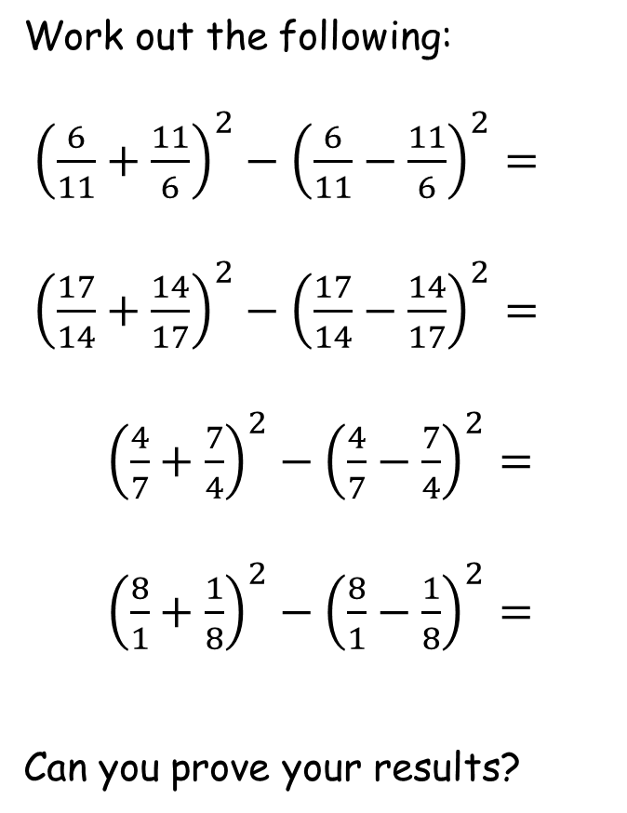
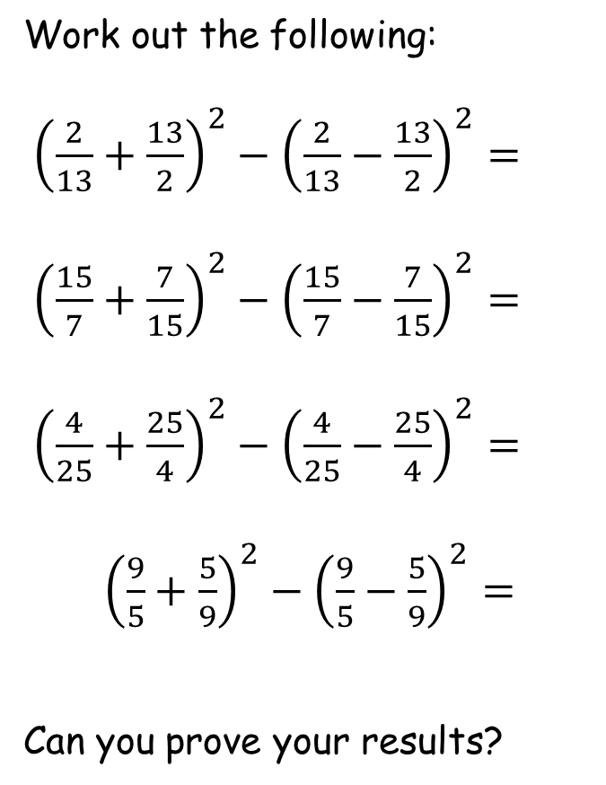
SIC_61
SIC_61
4 Squared Fractions
4 Squared Fractions
Work out the following:
${\left(\frac{6}{11}+\frac{11}{6}\right)}^{2}−{\left(\frac{6}{11}−\frac{11}{6}\right)}^{2}=$
${\left(\frac{17}{14}+\frac{14}{17}\right)}^{2}−{\left(\frac{17}{14}−\frac{14}{17}\right)}^{2}=$
${\left(\frac{4}{7}+\frac{7}{4}\right)}^{2}−{\left(\frac{4}{7}−\frac{7}{4}\right)}^{2}=$
${\left(\frac{8}{1}+\frac{1}{8}\right)}^{2}−{\left(\frac{8}{1}−\frac{1}{8}\right)}^{2}=$
Can you prove your results?
Work out the following:
${\left(\frac{2}{13}+\frac{13}{2}\right)}^{2}−{\left(\frac{2}{13}−\frac{13}{2}\right)}^{2}=$
${\left(\frac{15}{7}+\frac{7}{15}\right)}^{2}−{\left(\frac{15}{7}−\frac{7}{15}\right)}^{2}=$
${\left(\frac{4}{25}+\frac{25}{4}\right)}^{2}−{\left(\frac{4}{25}−\frac{25}{4}\right)}^{2}=$
${\left(\frac{9}{5}+\frac{5}{9}\right)}^{2}−{\left(\frac{9}{5}−\frac{5}{9}\right)}^{2}=$
Can you prove your results?

Slide 10
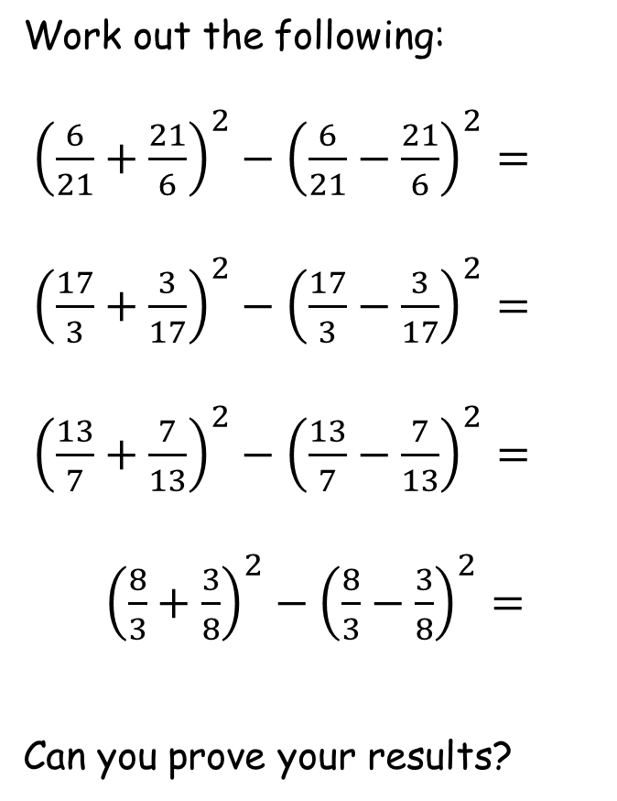
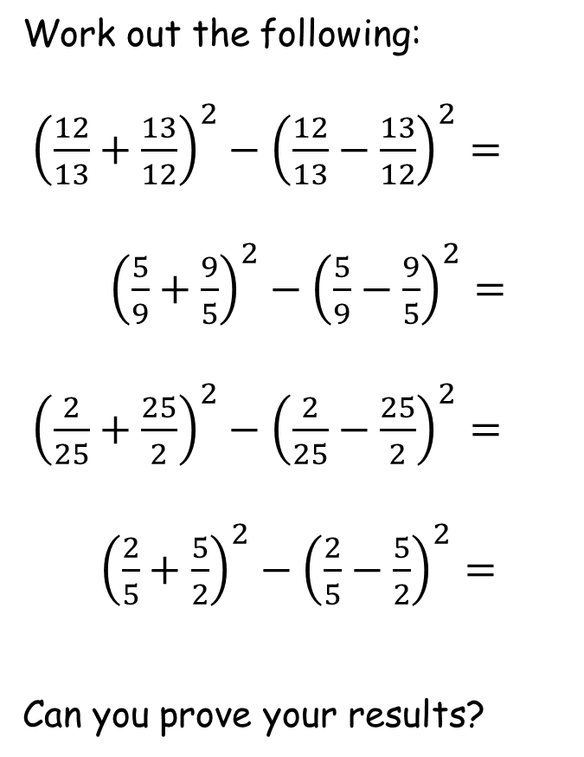
SIC_61
SIC_61
4 Squared Fractions
4 Squared Fractions
Work out the following:
${\left(\frac{6}{21}+\frac{21}{6}\right)}^{2}−{\left(\frac{6}{21}−\frac{21}{6}\right)}^{2}=$
${\left(\frac{17}{3}+\frac{3}{17}\right)}^{2}−{\left(\frac{17}{3}−\frac{3}{17}\right)}^{2}=$
${\left(\frac{13}{7}+\frac{7}{13}\right)}^{2}−{\left(\frac{13}{7}−\frac{7}{13}\right)}^{2}=$
${\left(\frac{8}{3}+\frac{3}{8}\right)}^{2}−{\left(\frac{8}{3}−\frac{3}{8}\right)}^{2}=$
Can you prove your results?
Work out the following:
${\left(\frac{12}{13}+\frac{13}{12}\right)}^{2}−{\left(\frac{12}{13}−\frac{13}{12}\right)}^{2}=$
${\left(\frac{5}{9}+\frac{9}{5}\right)}^{2}−{\left(\frac{5}{9}−\frac{9}{5}\right)}^{2}=$
${\left(\frac{2}{25}+\frac{25}{2}\right)}^{2}−{\left(\frac{2}{25}−\frac{25}{2}\right)}^{2}=$
${\left(\frac{2}{5}+\frac{5}{2}\right)}^{2}−{\left(\frac{2}{5}−\frac{5}{2}\right)}^{2}=$
Can you prove your results?

Slide 11
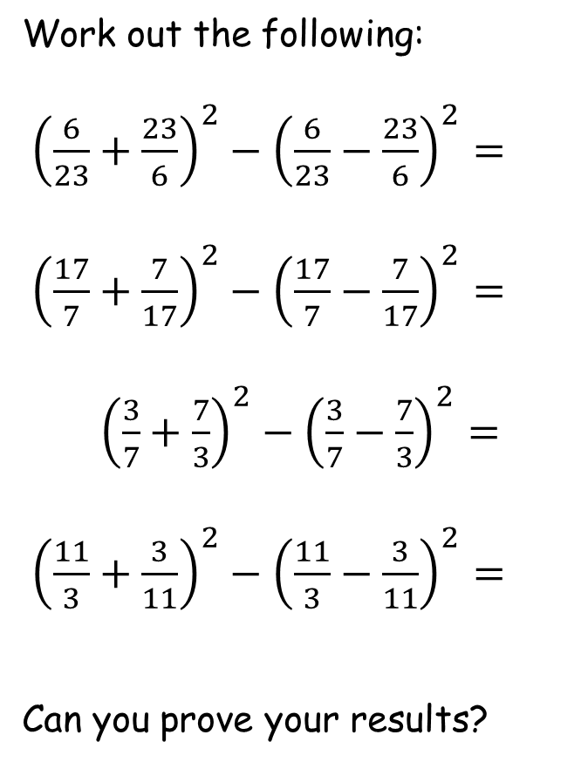
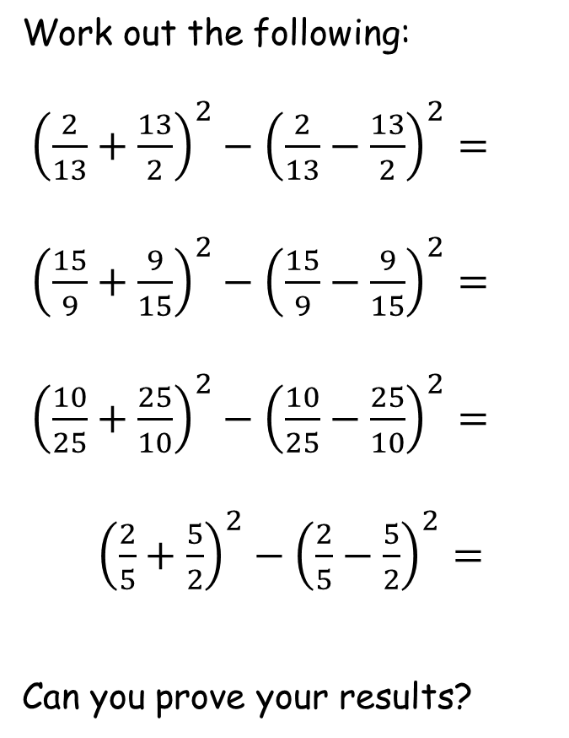
SIC_61
SIC_61
4 Squared Fractions
4 Squared Fractions
Work out the following:
${\left(\frac{6}{23}+\frac{23}{6}\right)}^{2}−{\left(\frac{6}{23}−\frac{23}{6}\right)}^{2}=$
${\left(\frac{17}{7}+\frac{7}{17}\right)}^{2}−{\left(\frac{17}{7}−\frac{7}{17}\right)}^{2}=$
${\left(\frac{3}{7}+\frac{7}{3}\right)}^{2}−{\left(\frac{3}{7}−\frac{7}{3}\right)}^{2}=$
${\left(\frac{11}{3}+\frac{3}{11}\right)}^{2}−{\left(\frac{11}{3}−\frac{3}{11}\right)}^{2}=$
Can you prove your results?
Work out the following:
${\left(\frac{2}{13}+\frac{13}{2}\right)}^{2}−{\left(\frac{2}{13}−\frac{13}{2}\right)}^{2}=$
${\left(\frac{15}{9}+\frac{9}{15}\right)}^{2}−{\left(\frac{15}{9}−\frac{9}{15}\right)}^{2}=$
${\left(\frac{10}{25}+\frac{25}{10}\right)}^{2}−{\left(\frac{10}{25}−\frac{25}{10}\right)}^{2}=$
${\left(\frac{2}{5}+\frac{5}{2}\right)}^{2}−{\left(\frac{2}{5}−\frac{5}{2}\right)}^{2}=$
Can you prove your results?

